Slide 1
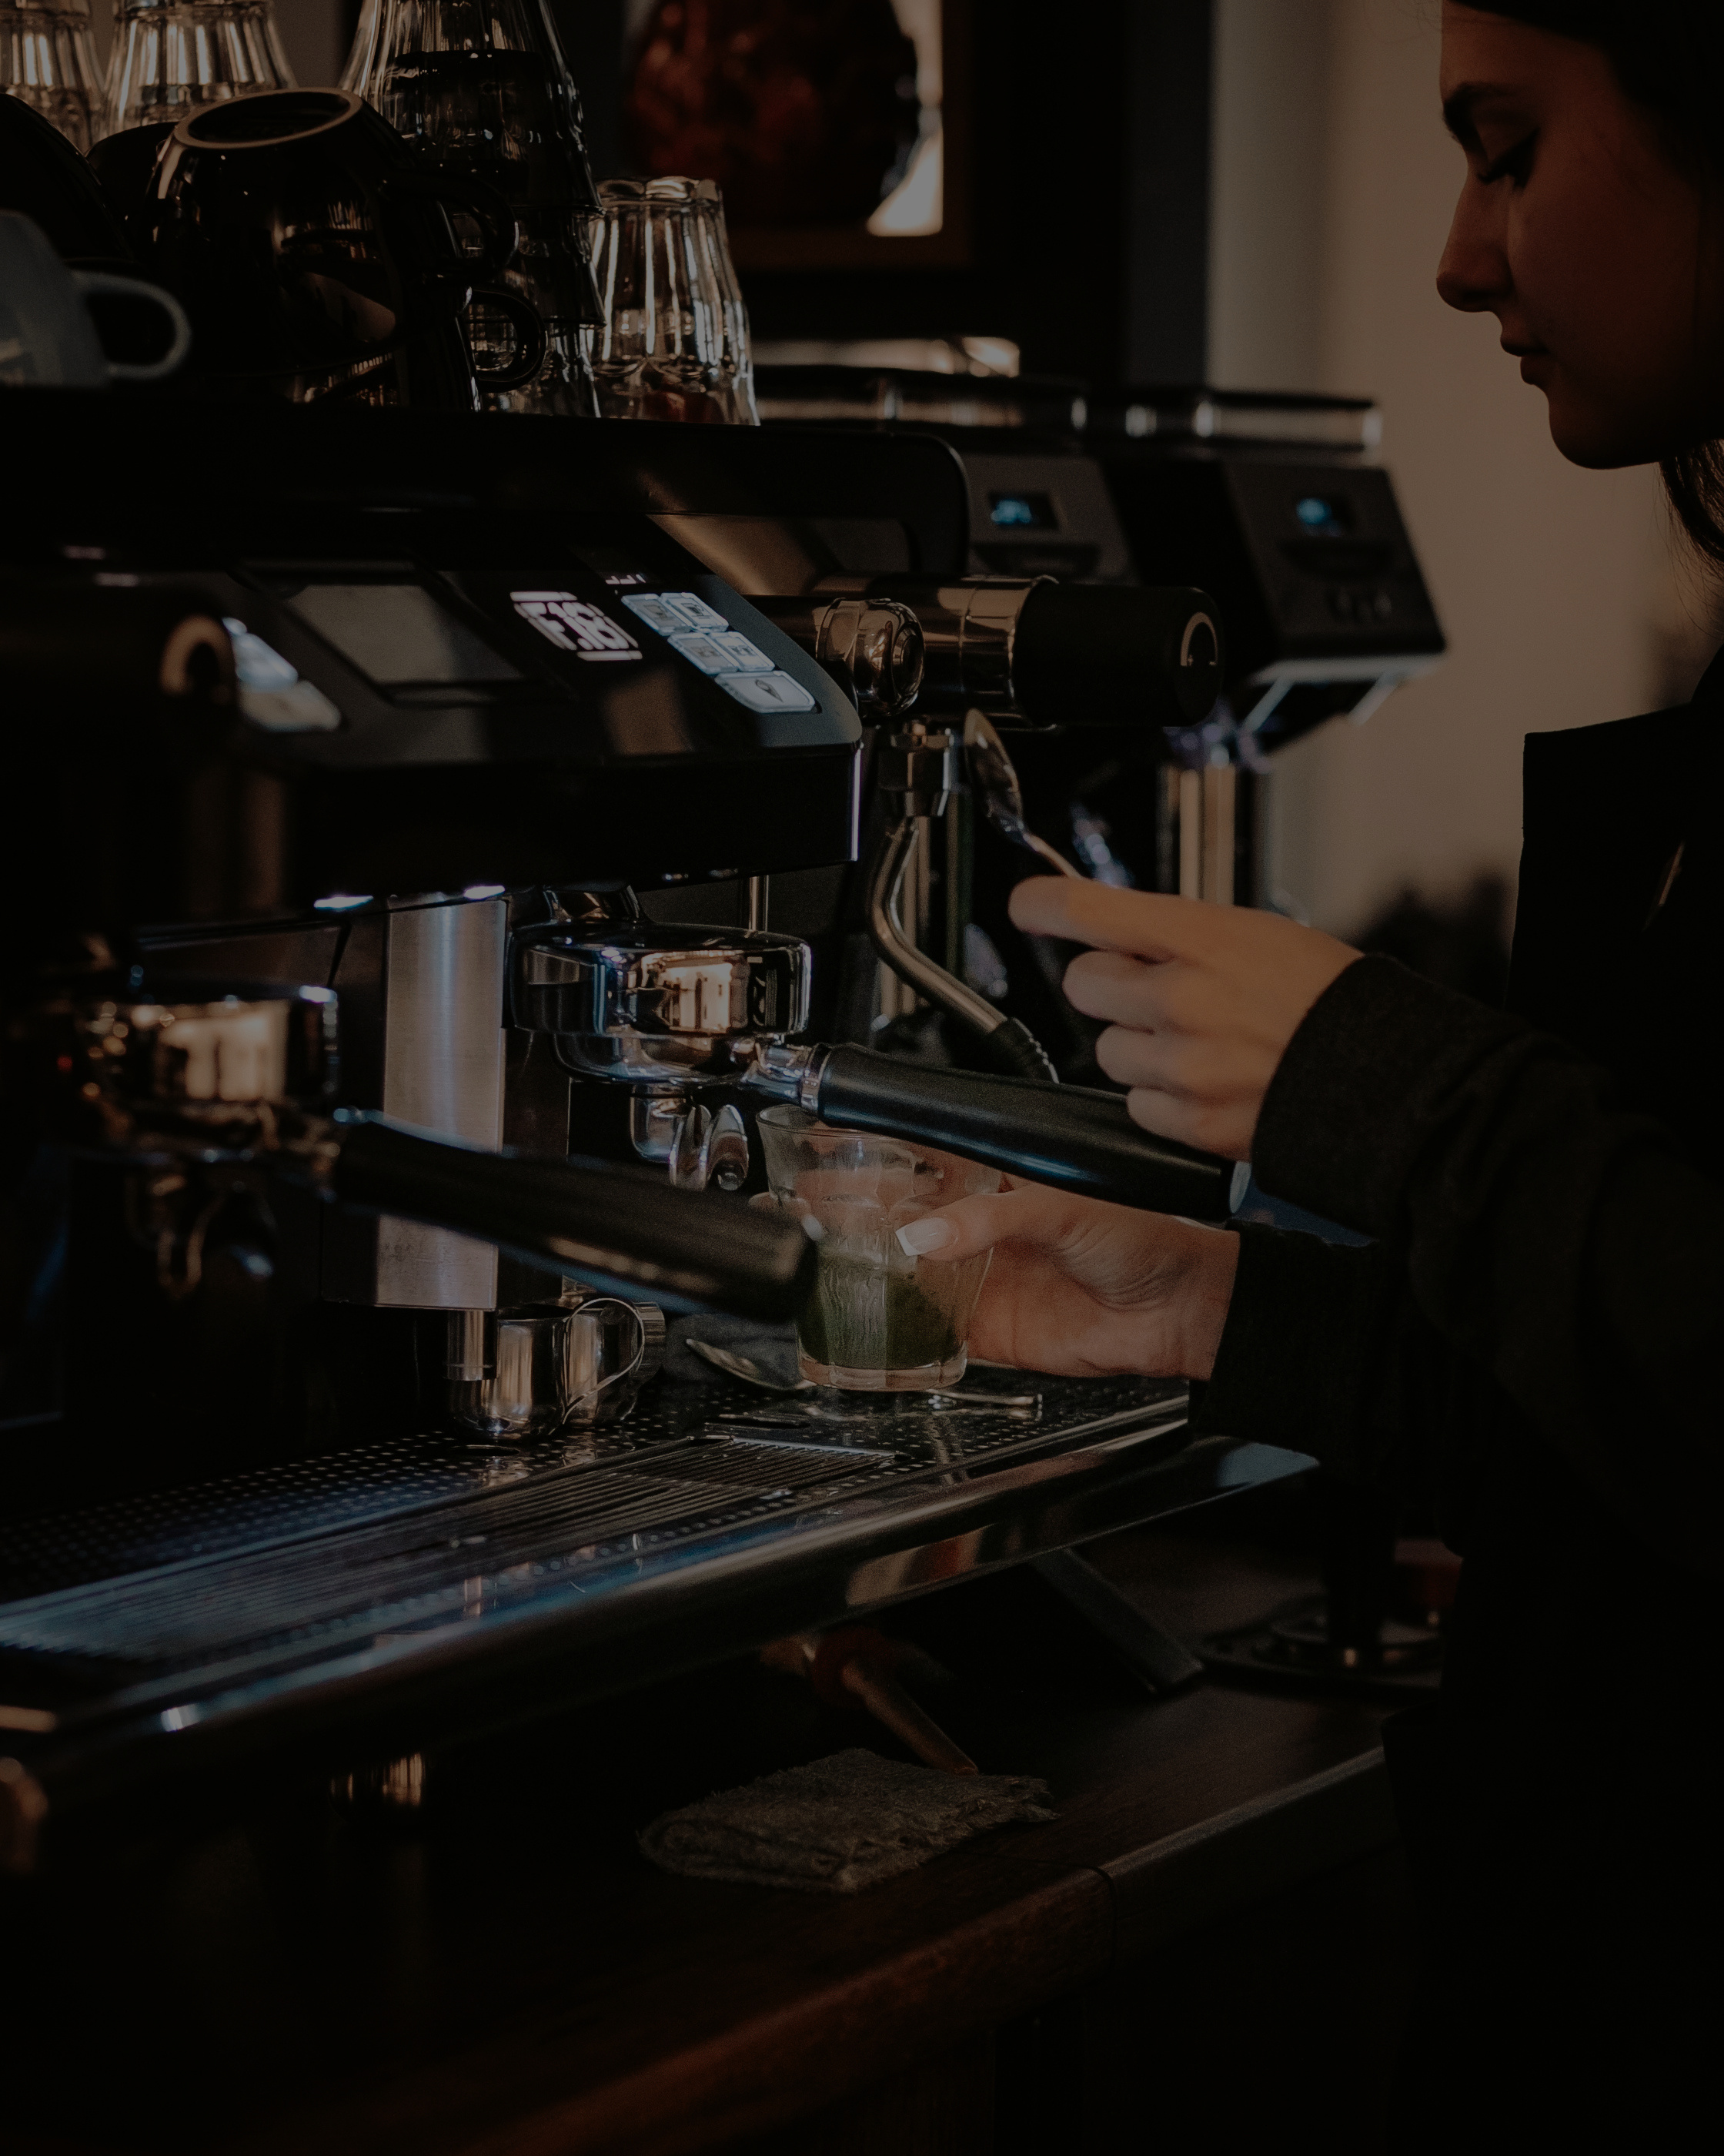



Bright Coffee Shop
COFFEE SHOP

Slide 2

CONTENT
Introduction
Data Analysis
Recommendations

Slide 3


Bright Coffee Shop
INTRODUCTION
Analysis of Bright Coffee Shop Sales Data
This project examines the sales data from Bright Coffee Shop to reveal important business insights.
Key Focus Areas
Customer behavior
Product performance
Sales performance
Revenue trends
This analysis serves as a valuable tool for improving decision-making based on historical data.

Slide 4
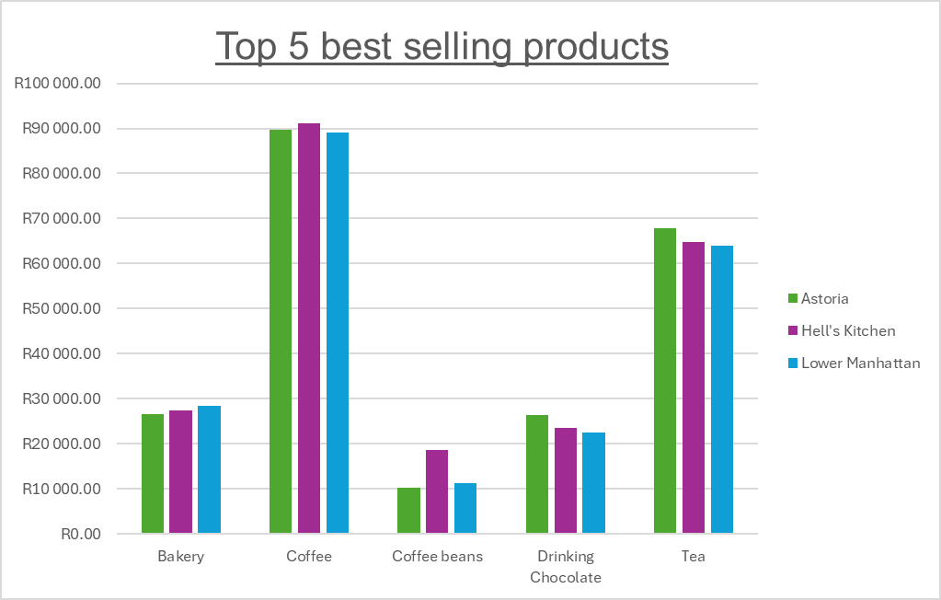
Analysis: Best Selling product
Insight: Coffee and Tea dominate sales, contributing the majority of revenue.

Slide 5
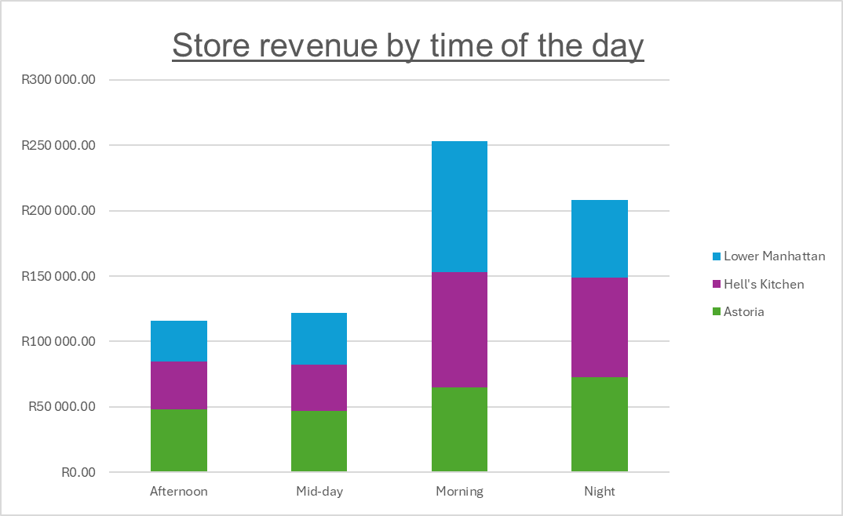
Analysis: Store revenue by time
Insight: Morning sales peak due to Lower Manhattan's strong performance, while Hell’s Kitchen and Astoria contribute consistent revenue throughout the day and night.

Slide 6
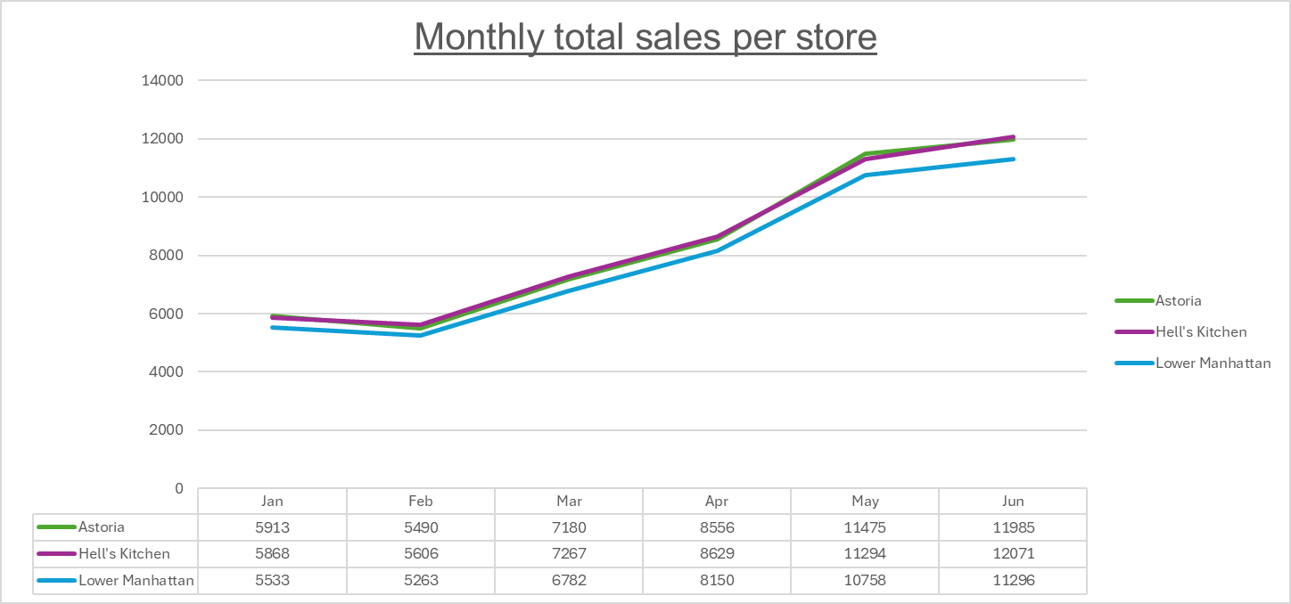
Analysis: Monthly total sales per store
Insight: All three stores demonstrate a high level of operational consistency, moving in nearly perfect lockstep through the first half of the year. The top performer is Hell's Kitchen, followed by Astoria and Lower Manhattan is trailing yet keeping up.

Slide 7
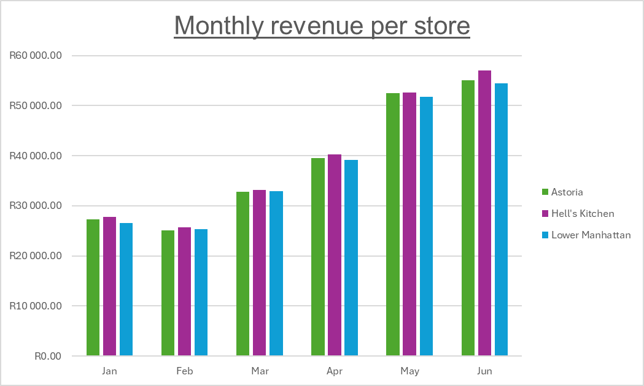
Analysis: Hotspot locations
Insight: Revenue consistently accelerated across all stores from March through June, with Hell's Kitchen maintaining a slight but steady competitive edge as the top-grossing location each month.

Slide 8
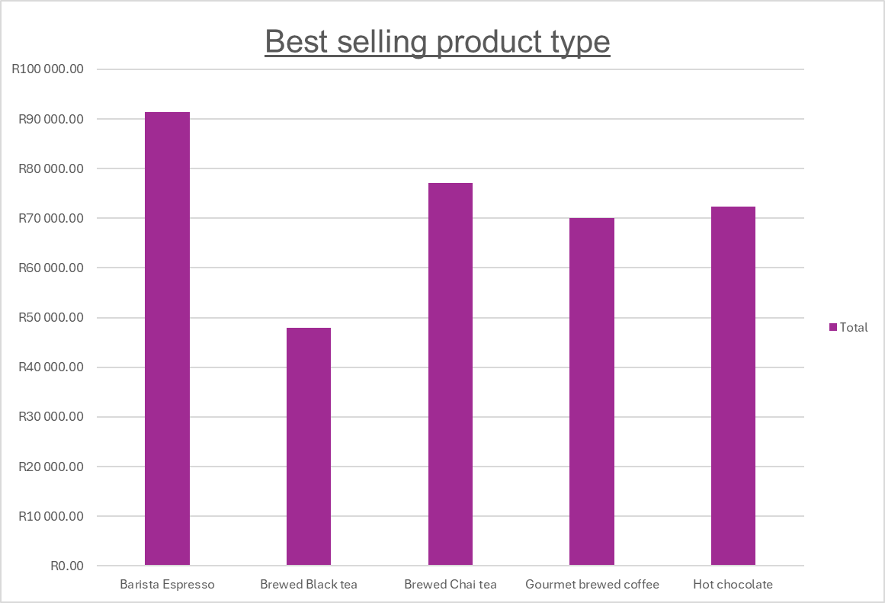
Analysis: Best Selling product type
Insight: Coffee is the undisputed leader, generating significantly more revenue than any other category, followed by Tea and Bakery.

Slide 9
Recommendations
Morning Dominance: Revenue is highest during the morning hours (approx. R253,000 total), particularly in Lower Manhattan and Hell’s Kitchen. This is the "rush hour."
The Afternoon Slump: There is a significant dip in sales during the mid-day and afternoon periods across all stores. This represents the greatest opportunity for growth.
Night Strength: Surprisingly, the stores maintain strong performance at night (approx. R208,000), with Astoria leading this segment.
Top Products: Barista Espresso and Brewed Chai Tea are your primary revenue drivers. Hot Chocolate also shows strong consistent performance across all locations.

Slide 10
Bright Coffee Shop
THANK
YOU

